Slide 1
Sound
Mwayi Mchuchu

Slide 2
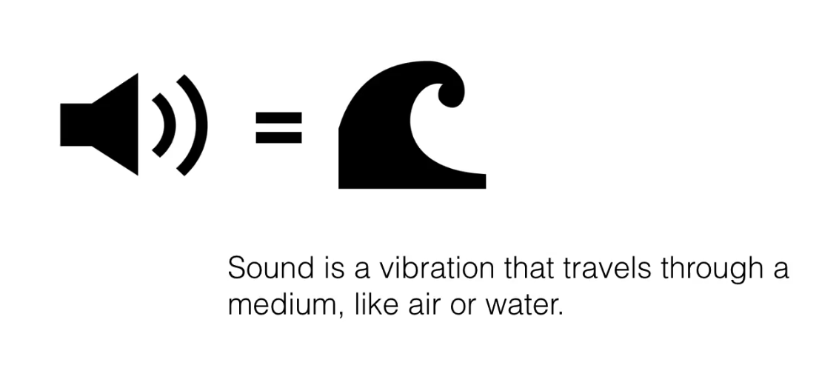
What is sound

Slide 3
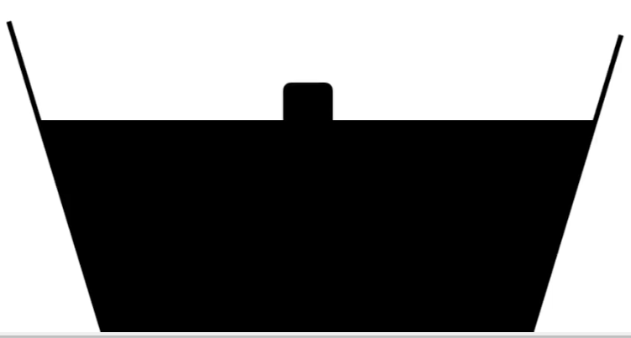
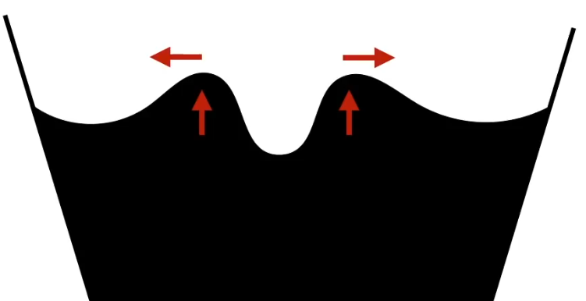
Sound waves vibrations
If you drop a stone in a bucket of water you disturb the water surface the stone creates ripples or waves which travels away from the impact.
The ripples cause the water to change up and down

Slide 4
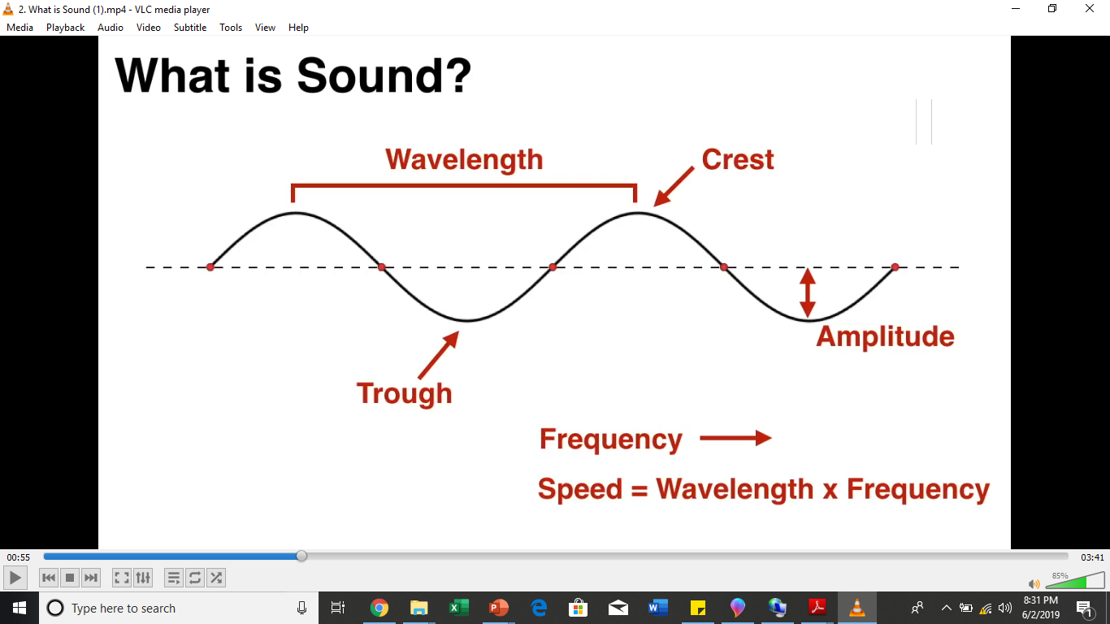
Sound waves
The sound waves have a number of properties
Crest us the maximum point
Minimum point is called a trough
Wavelength (A distance between one crest to another )
Amplitude (Distance between the center line to the trough or crest)
Frequency number of waves passing a fixed point per second

Slide 5
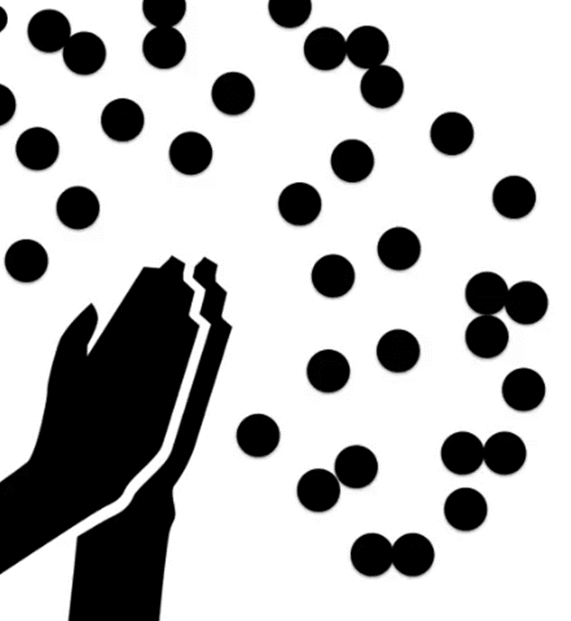
Sound waves continued
Sound waves are similar, if you crap your hands for example inside your room, you will disturb the air and cause ripples of air to move away from your hand

Slide 6
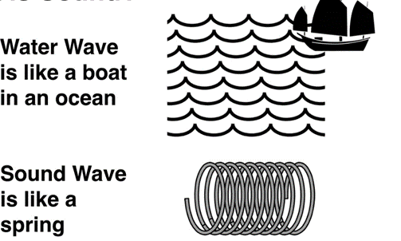
Difference between soundwaves and water waves
Water waves are transverse (as waves moves a disturbance is created perpendicular direction (vertically up and down) )
Sound waves are longitudinal (disturbance is created in the same wave direction)
Transverse waves coming from behind can lifts you and drops you down
Longitudinal waves can push forward and brings u back like a spring
Why talking about water wave on sound?
When representing sound waves digitally it is still drawn like transverse waves
Its like simply because its easier to draw and present the waves like that so
that it looks like a regular sign graph, but in this case it represents the
Motion of air particles traveling through time.

Slide 7
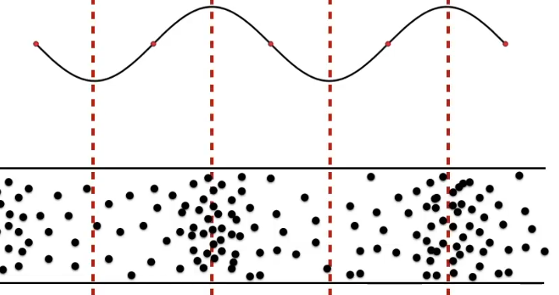
Sound waves effect on air
Crest point brings air particles together and trough spreads them apart
Sound waves causes changes in air pressure we can’t see this effect but we can hear it with our ears as particles bunch together and spread apart. This also causes our eardrums go in and out in the same rate and when the brain analyses the signals and interprets them as sound.
Sound has a speed of 343 Meters / second
The frequency determines pitch of the sound
Shorter wavelength = higher frequency = higher pith
Amplitude (energy of the wave) affect Volume of the sound

Slide 8
Sound pressure
Sound pressure levels (loudness or volume) are measured in decibels (dB).
The decibel ( dB) is used to measure sound level, but it is also widely used in electronics, signals and communication. The dB is a logarithmic way of describing a ratio. The ratio may be power, sound pressure, voltage or intensity or several other things.
Sound is usually measured with microphones and they respond (approximately) proportionally to the sound pressure, p.
goes as the square of the pressure. (Similarly, electrical power in a resistor goes as the square of the voltage.)

Slide 9
Measuring sound Pressure (loudness) in dB
The log of the square of x is just 2 log x, so this introduces a factor of 2 when we convert to decibels for pressures. The difference in sound pressure level between two sounds with p₁ and p₂ is therefore:
20 log (p₂/p₁) dB = 10 log (p₂²/p₁²) dB = 10 log (P₂/P₁) dB where again the log is to base 10.
For instance, suppose we have two loudspeakers, the first playing a sound with power P₁, and another playing a louder version of the same sound with power P₂, but everything else (how far away, frequency) kept the same.
The difference in decibels between the two is defined to be 10 log (P₂/P₁) dB where the log is to base 10.
If the second produces twice as much power than the first, the difference in dB is10 log (P₂/P₁) = 10 log 2 = 3 dB.
if the second had 10 times the power of the first, the difference in dB would be10 log (P₂/P₁) = 10 log 10 = 10 dB.
If the second had a million times the power of the first, the difference in dB would be?

Slide 10
Multimedia system sounds
System sounds are assigned to various system events such as startup and warnings, among others.
Macintosh provides several system sound options such as glass, indigo, laugh.
In Windows, available system sounds include start.wav, chimes.wav, and chord.wav.
Multimedia sound is either digitally recorded audio or MIDI (Musical Instrumental Digital Interface) music.

Slide 11
Digital sound
analog audio. Is basically Recording audio in a format of continuous vibrations that are comparable to the original sound waves. Before audio recording became digital, sounds were "carved" into vinyl records or written to tape as magnetic continuous signal waveforms.
Digital audio is a technology that is used to record, store, manipulate, generate and reproduce sound using audio signals that have been encoded in digital form. It also refers to the sequence of discreet samples that are taken from an analog audio waveform.
Sounds can be recorded using a microphone, which converts the air vibrations of the sound into an electrical signal. This signal can then be quantified—but the digitization must include quantifying magnitude (loudness) and time.
How does digital audio work?. Digital audio is a representation of an analog audio signal used by computers and digital devices. sound is converted with an analog-to-digital converter (ADC) into a digital binary signal, typically using pulse-code modulation to record and playback sound. Similar to the frames of a video, digital audio is made up of a series of samples which recreate a sound when played back in sequence.

Slide 12
Digital audio continued
Quality of digital recording depends on the sampling rate, (or frequency) that is, the number of samples taken per second.
The number of bits used to describe the amplitude of sound wave when sampled, determines the sample size.
Crucial aspects of preparing digital audio files are:
Balancing the need for sound quality against available RAM and hard disk resource.
Setting appropriate recording levels to get a high-quality and clean recording.
Once a recording had been completed, it almost always needs to be edited.
Basic sound editing operations include trimming, splicing and assembly, volume adjustments and working on multiple tracks.

Slide 13
Digital audio common sample rates
Audio resolution determines the accuracy with which sound can be digitized.
Audio resolution refers to the sample rate, the number of samples or measurements taken each second from a recording. The typical CD sample rate is 44.1KHz, or 44,100 samples per second.
Sample size are either 8bits or 16bits and 24bits The larger the sample size the better the date describes sound.(better quality). The higher the sample rate the higher the sound quality the bigger the file size. Even for professional sounds the 44.KHz sample rate is still common.
For MP3format the Mp3 streaming bit rates and sample rate for stereo may range from 96–320 kbps/44.1–48KHz, the preferred bit rates are 128Kbps/44.1KHz, 96Kbps/44.1KHz. Recent MP3 rates are 320 kilobits/second. (do a personal research on this for further clarifications)

Slide 14
MIDI Audio
MIDI (Musical Instrument Digital Interface) is a protocol designed for recording and playing back music on digital synthesizers that is supported by many makes of personal computer sound cards. With a program that provides this interface, you can create music using a standard keyboard or other input device.
A MIDI signal is normally generated by a keyboard, and it contains information about which keys are being pressed. The MIDI signal can be recorded on a MIDI track of a digital audio workstation. (commonly used in music studios)
A MIDI file does not contain an audio recording in the same way an Mp3 or WAV file does. It contains a set of instructions telling a computer or hardware sequencer how to play it. Therefore, the MIDI file will not sound anything like an Mp3 track, and may even sound quite different when played on different devices. Think of MIDI as similar to vector graphics.
A MIDI instrument contains ports to send and receive MIDI signals, a CPU to process those signals, an interface that allows user programming, audio circuitry to generate sound, and controllers.

Slide 15
MIDI audio continued
MIDI is device dependent. Playback will be accurate if playback device matched the file production device properties. Midi sends events data signals and computational devices interprets the signals electronically producing sound to the speaker.
Basically MIDI audio is a numerically generated type of audio just like vector graphics and think of digital audio as bitmaps. Or MIDI is a shorthand representation of music stored in numeric form.
MIDI files are small in size and, when embedded in web pages load and play promptly.
Length of a MIDI file can be changed without affecting the pitch of the music or degrading audio quality. In music recording MIDI data will be represented with bars common in most audio recording software like FLStudio. The bars can be extended trimmed, adjust tempo change pitch on just one section etc. without affecting the quality of the audio.
Working with MIDI requires knowledge of music theory.

Slide 16
MIDI vs Digital Audio
MIDI is analogous (similar) to structured or vector graphics, while digitized audio is analogous to bitmapped images.
MIDI is device dependent while digitized audio is device independent.
MIDI files are much smaller than digitized audio.
MIDI files sound better than digital audio files when played on a high-quality MIDI device.

Slide 17
MIDI vs Digital Audio
With MIDI, it is difficult to playback spoken dialog (as its an electronically generated sound and not recorded), while digitized audio can do so with ease.
MIDI records events data while digital audio records wave data.
One requires knowledge of music theory in order to run MIDI, while digital audio does not have this requirement.
Digital is often used in multimedia projects than MIDI
Digital audio requires more RAM and hard disk space to store or play audio while MIDI

Slide 18
Mono and stereo audio sounds
Mono
or monophonic describes a system where all the audio signals are mixed together and routed through a single audio channel. A signal channel can be an audio communication medium. Or in other words a representation of sound coming from or going to a single point.
Mono systems can have multiple loudspeakers, and even multiple widely separated loudspeakers. The key is that the signal contains no level and arrival time/phase information that would replicate or simulate directional cues. This being the case all the speaker will play the same exact audio at the same time and the audio may sound flat.
Stereo
True stereophonic sound systems have two independent audio signal channels, and the signals that are reproduced have a specific level and phase relationship to each other so that when played back through a suitable reproduction system, there will be an apparent image of the original sound source. Stereo mics might have 2 physical mics inside, one pointing to the left and another to the right.
Stereo would be a requirement if there is a need to replicate the aural perspective and localization of instruments on a stage or platform, a very common requirement in performing arts centers.

Slide 19
When to use mono or stereo
The big advantage to mono is that everyone hears the very same signal, and, in properly designed systems, all listeners would hear the system at essentially the same sound level.
This makes well-designed mono systems very well suited for speech reinforcement as they can provide excellent speech intelligibility.
Stereo is usually common for music and or audio that will require a high sense of clarity and not flat sound.
2 speakers in a stereo mode one can play for instance the base and drum plus lead guitar the other can play voice piano and violin due to the harmonization of the sound both ears might hear a beautiful symphony of higher clarity

Slide 20
Adding sound to multimedia projects
File formats compatible with multimedia authoring software being used along with delivery mediums, must be determined.
Sound playback capabilities offered by end user’s system must be studied. (eg will the project be played on dvd player?, on the web or computer etc.)
The type of sound, whether background music, special sound effects, or spoken dialog, must be decided.
Digital audio or MIDI data should be selected on the basis of the location and time of use.
The equipment and standards used for the project must be in accordance with the requirements.
It is vital to maintain a high-quality database that stores the original sound material. Sound and image synchronization must be tested at regular intervals. Eg lip sinking in case of a music video

Slide 21
Midi examples
Example
example2

Slide 22
End of presentation
References
System Design group [2015] mcsquared [online] available at http://www.mcsquared.com/mono-stereo.htm Accessed on [2/6/2019]

